Slide 1
About Me
Ritesh Singh
Sun Certified java Professional
Oracle Certified Database Administrator
Certified Ethical Hacker
Certified EC-Council Instructor (CEI)

Slide 2
Course Overview
Introduction to MySQL HAVING clause

Slide 3
The HAVING clause is used in the SELECT statement to specify filter conditions for a group of rows or aggregates.
The HAVING clause is often used with the GROUP BY clause to filter groups based on a specified condition. If the GROUP BY clause is omitted, the HAVING clause behaves like the WHERE clause.

Slide 4
The following illustrates the syntax of the HAVING clause:
SELECT
select_list
FROM
table_name
WHERE
search_condition
GROUP BY
group_by_expression
HAVING
group_condition;

Slide 5
In this syntax, you specify a condition in the HAVING clause. If a row, which is generated by the group by clause, causes the group_condition to evaluate to true, the query will include it in the result set.
Notice that the HAVING clause applies a filter condition to each group of rows, while the WHERE clause applies the filter condition to each individual row.

Slide 6
MySQL evaluates the HAVING clause after the FROM, WHERE, SELECT and GROUP BY clauses and before ORDER BY, and LIMIT clauses.
Note that the SQL standard specifies that the HAVING is evaluated before SELECT clause and after GROUP BY clause.

Slide 7
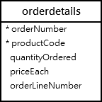
MySQL HAVING clause examples
Let’s take some examples of using the HAVING clause to see how it works. We’ll use the orderdetails table in the sample database for the demonstration.

Slide 8
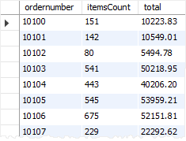
The following uses the GROUP BY clause to get order numbers, the number of items sold per order, and total sales for each from the orderdetails table:
SELECT
ordernumber,
SUM(quantityOrdered) AS itemsCount,
SUM(priceeach*quantityOrdered) AS total
FROM
orderdetails
GROUP BY ordernumber;

Slide 9
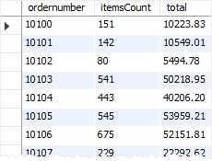
Now, you can find which order has total sales greater than 1000 by using the HAVING clause as follows:
SELECT
ordernumber,
SUM(quantityOrdered) AS itemsCount,
SUM(priceeach*quantityOrdered) AS total
FROM
orderdetails
GROUP BY
ordernumber
HAVING
total > 1000;

Slide 10
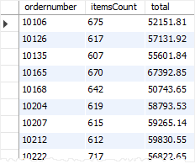
You can construct a complex condition in the HAVING clause using logical operators such as OR and AND.
The following example uses the HAVING clause to find orders that have total amounts greater than 1000 and contain more than 600 items:
SELECT
ordernumber,
SUM(quantityOrdered) AS itemsCount,
SUM(priceeach*quantityOrdered) AS total
FROM
orderdetails
GROUP BY ordernumber
HAVING
total > 1000 AND
itemsCount > 600;

Slide 11
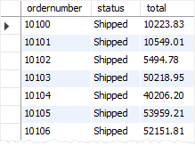
Suppose that you want to find all orders that are in shipped status and have the total amount greater than 1500, you can join the orderdetails table with the orders table using the INNER JOIN clause and apply a condition on status column and total aggregate as shown in the following query:
SELECT
a.ordernumber,
status,
SUM(priceeach*quantityOrdered) total
FROM
orderdetails a
INNER JOIN orders b
ON b.ordernumber = a.ordernumber
GROUP BY
ordernumber,
status
HAVING
status = 'Shipped' AND
total > 1500;

Slide 12
The HAVING clause is only useful when you use it with the GROUP BY clause to generate the output of the high-level reports. For example, you can use the HAVING clause to answer questions like finding the number orders this month, this quarter, or this year that have total sales greater than 10K.

Slide 13
Thank You
Please Subscribe My Channel
https://www.youtube.com/channel/UCYW3PWPOPn3qgxxjhUbXXXg?view_as=subscriber

